Slide 1
Enterprise Programmering 2 Lesson 02: Web APIs
Prof. Andrea Arcuri

Slide 2
Goals
Refresh knowledge of HTTP protocol
Look at how to provide data/operations over the network with a Web Service
In the code we will use the term REST, but will not follow yet its architectural guidelines
We will go into its details in Lesson 04
We will see other kinds of web services (SOAP and GraphQL) much later in the course

Slide 3
HTTP

Slide 4
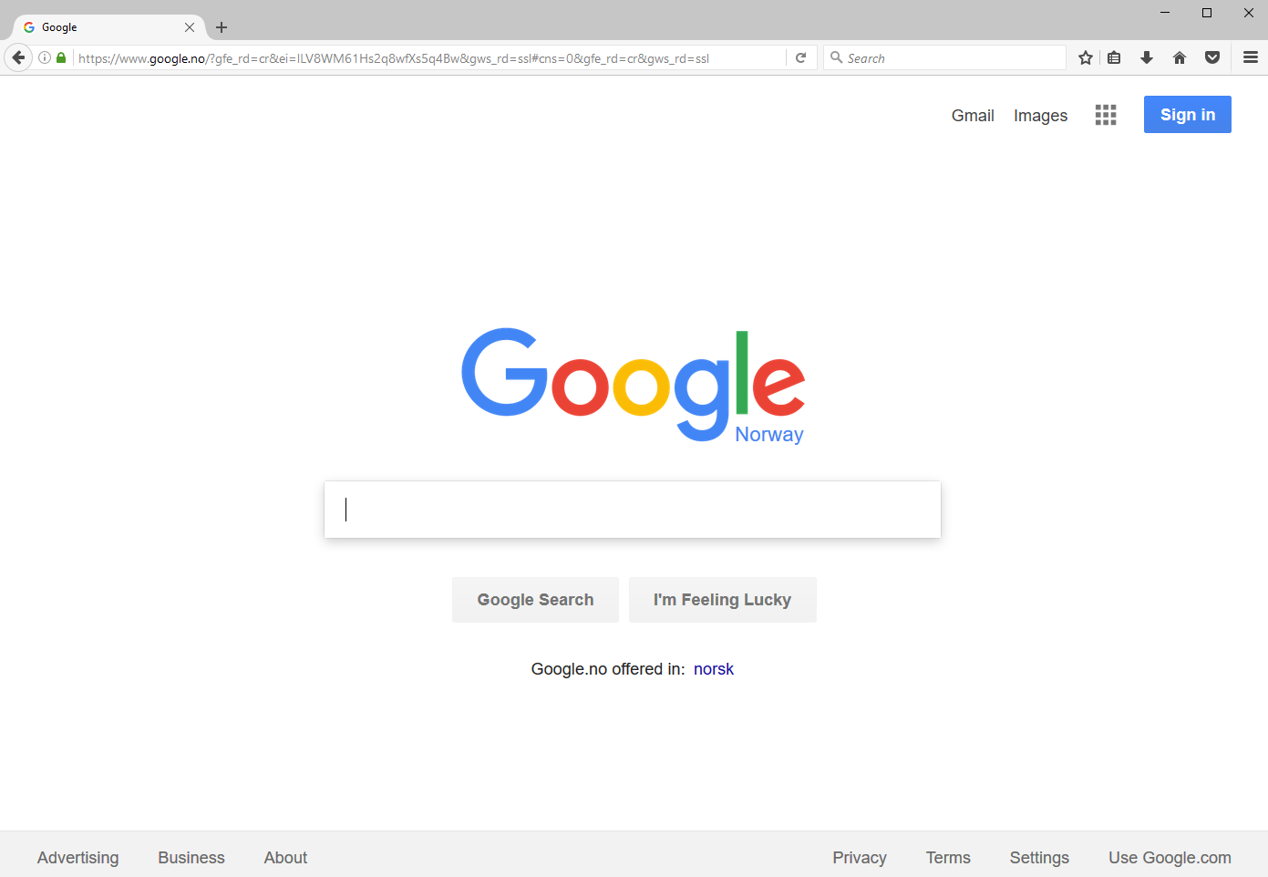

Slide 5
Send a HTTP request over TCP, and get back a HTML page which will be visualized in the browser

Slide 6
URL (Uniform Resource Locator)
Reference to a web resource and how to retrieve it
scheme:[//[user:password@]host[:port]][/]path[?query][#fragment]
https://en.wikipedia.org:443/wiki/Uniform_Resource_Locator#Syntax
scheme
port
fragmet
host
path

Slide 7
Cont.
Scheme: how to access the resource
http, https, file, ftp, etc.
Host: the name of the server, or directly its numeric IP address
Port: the listening port you will connect to on the remote server
Path: identifies the resource, usually in a hierarchical format
Eg, /a/b/c
Query: starting with “?”, list of <key>=<value> properties, separated by “&”
eg https://github.com/search?q=java&type=Repositories&ref=searchresults
Fragment: identifier of further resource, usually inside the main you requested
Eg, a section inside an HTML page

Slide 8
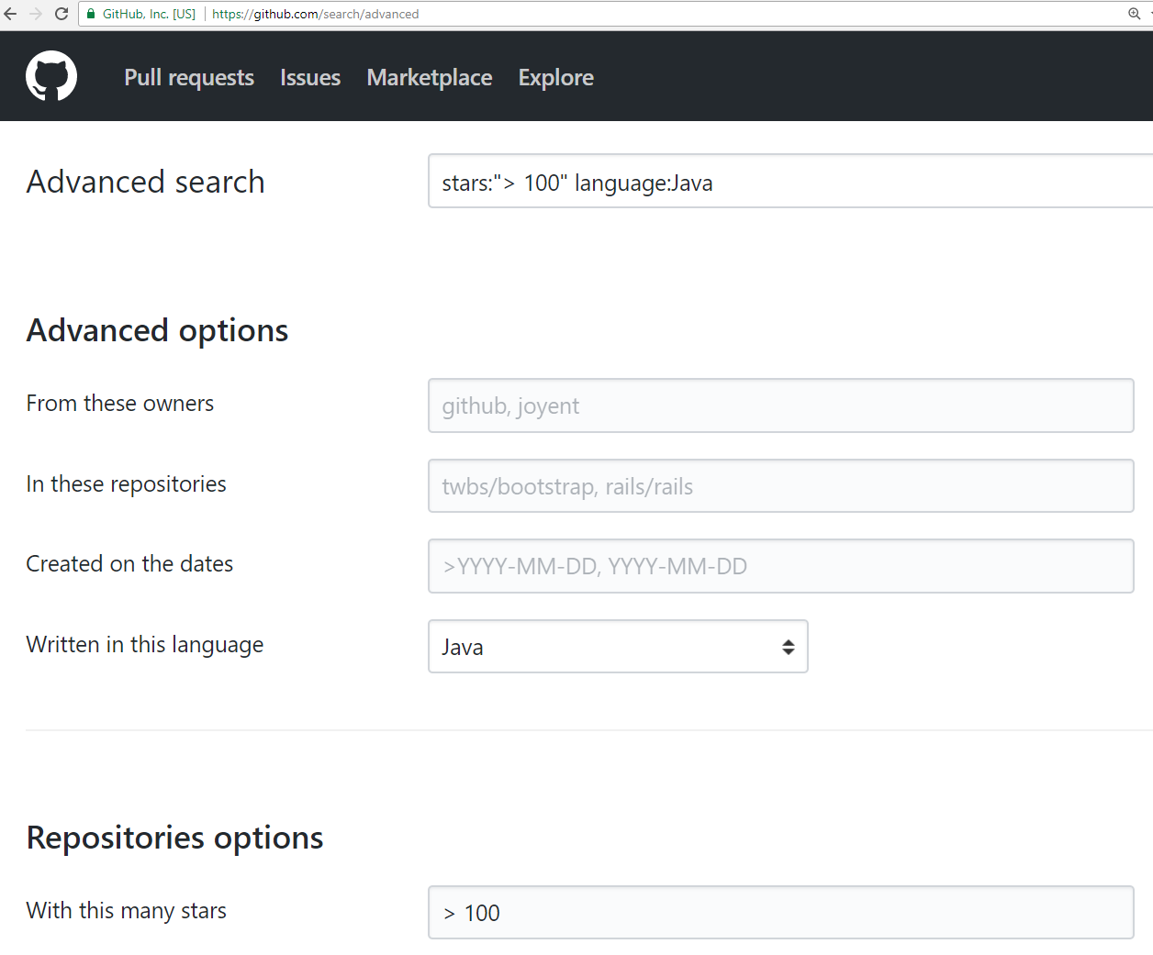
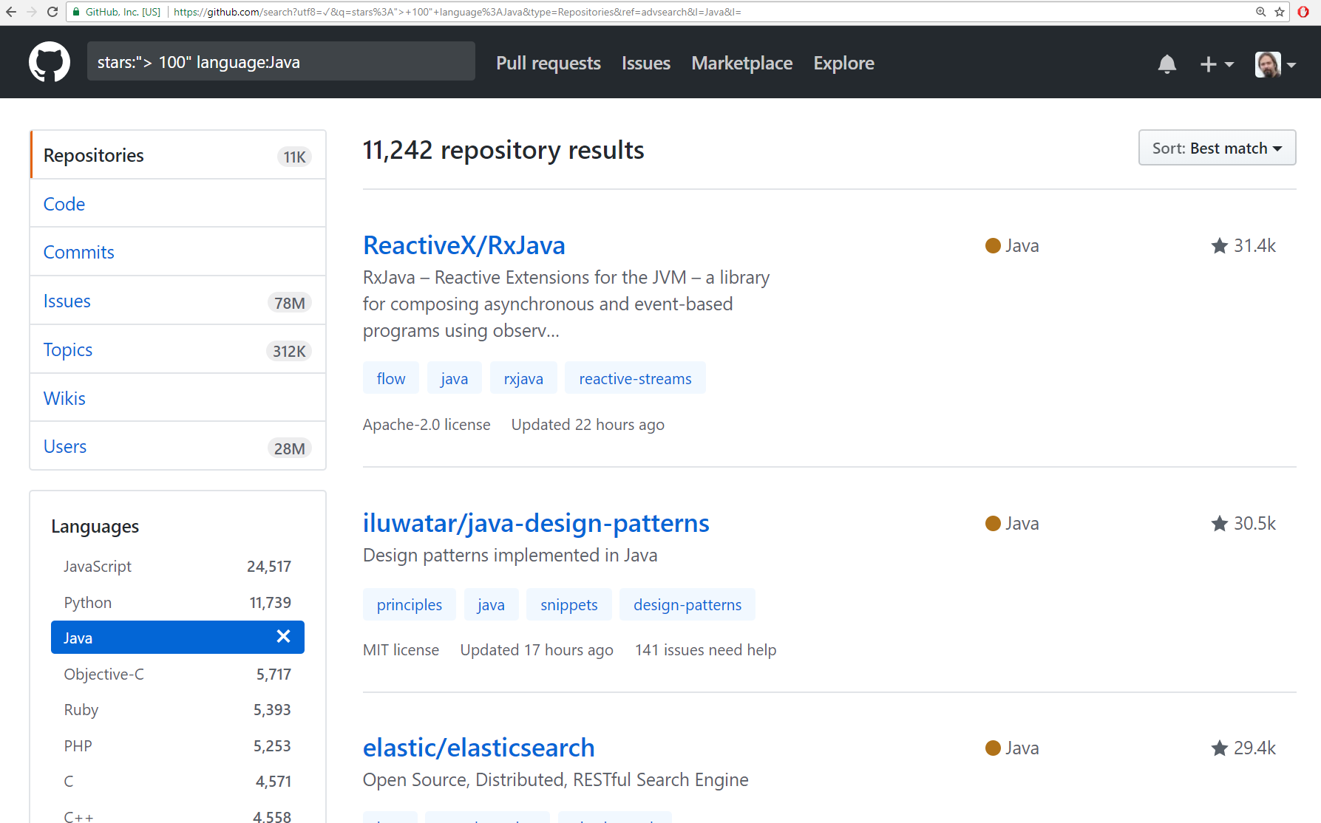
https://github.com/search?utf8=%E2%9C%93&q=stars%3A%22%3E+100%22+language%3AJava&type=Repositories&ref=advsearch&l=Java&l=
The asked page/resource is /search, where it is retrieved in different ways based on the list of query “?” parameters

Slide 9
URI (Uniform Resource Identifier)
String of characters used to identify a resource
A URL is a URI:
Exactly same format
In URL, the resource is typically located on a network
Given a URL, you should be able to access the resource, which is not necessarily true for URI
The distinction between URL and URI is conceptually very thin
Most people use the two terms interchangeably

Slide 10
TCP not Enough
https://en.wikipedia.org:443/wiki/Uniform_Resource_Locator
host:port
Host and port are needed to establish a TCP connection
But what data should we send to specify that we want to retrieve the HTML page at that location?

Slide 11
HTTP History
Protocol Used to specify structure of messages
Started at CERN in 1989
1995: version 0.9
1996: version 1.1
1999: “updates” to 1.1
2014: more “updates” to 1.1
2015: version 2.0

Slide 12
Http Versioning: What a Mess!!!
HTTP is one the worst examples of versioning done wrong
Changing specs and semantics over 18 years, but still keeping the same version number 1.1!!!
Why? To support the largest number of browsers, even very old ones
Not many people realized there was an update in 2014… you might still find quite a few libraries/tools that wrongly use the 1999 version

Slide 13
RFC (Request for Comments)
Technically, a RFC is not a “standard” yet, but it is de-facto in practice
RFC 7230, HTTP/1.1: Message Syntax and Routing
RFC 7231, HTTP/1.1: Semantics and Content
RFC 7232, HTTP/1.1: Conditional Requests
RFC 7233, HTTP/1.1: Range Requests
RFC 7234, HTTP/1.1: Caching
RFC 7235, HTTP/1.1: Authentication
RFC 7540, HTTP/2
Etc.
When working with web services, it is fundamental to understand all the low level details of HTTP

Slide 14
HTTP 1.1 vs 2
v2 is quite recent (2015), and still not so common
Unless otherwise stated, we will just deal with v1.1
From user’s perspective, v2 is like v1.1
Same methods/verbs, just better optimization / performance improvement
More like adding functionalities, not replacing it
Main visible difference: v1.1 is “text” based, whereas v2 has its own byte format (less space, but more difficult to read/parse for humans)

Slide 15
HTTP Messages: 3 Main Parts
First line specifying the action you want to do, eg GET a specific resource
Set of headers to provide extra meta-info
eg in which format you want the response: JSON? Plain Text? XML?
In which language? Norwegian? English?
(Optional) Body: can be anything.
Request: usually to provide user data, eg, login/password in a submitted form
Response: the actual resource that is retrieved, eg a HTML page

Slide 16
First line
<METOD> <RESOURCE> <PROTOCOL> \r\n
Ex.: GET / HTTP/1.1
<method> GET
<resource> /
<protocol> HTTP/1.1
A resource can be anything
html, jpeg, json, xml, pdf, etc.
A resource is identified by its path
Recall URI, and such path is same as file-system on Mac/Linux, where “/” is the root

Slide 17
Different kinds of Methods
GET: to retrieve a resource
POST: to send data (in the HTTP body), and/or create a resource
PUT: to replace an existing resource with a new one
PATCH: to do a partial update on an existing resource
DELETE: to delete a resource
HEAD: like a GET, but only return headers, not the resource data
OPTIONS: to check what methods are available on a resource
TRACE: for debugging
CONNECT: tunneling connection through proxy

Slide 18
Method Semantics
Each of the methods has a clear semantics
Eg GET does retrieve a resource, whereas DELETE should delete it
But how the application server does handle them is completely up to it
Eg, an application server could delete a resource when a GET is executed

Slide 19
Verbs should not be in paths
Given a resource “/x.html”
Wrong: GET on “www.foo.org/x.html/delete” to delete “x.html”
Here the resource would be “/x.html/delete”
Also wrong to use query, eg “www.foo.org/x.html?method=delete”
Paths should represent/identify resources, and NOT actions on those

Slide 20
Idempotent Methods
RFC 7231: “A request method is considered idempotent if the intended effect on the server of multiple identical requests with that method is the same as the effect for a single such request...
… if a client sends a … request and the underlying connection is closed before any response is received, then the client can establish a new connection and retry the idempotent request.”

Slide 21


Which methods are idempotent?
GET
POST
DELETE
PUT
PATCH
HEAD

Slide 22
Headers
Extra meta-information, besides Method/Resource
Pairs <key>:<value>
For example:
In which format am I expecting the resource? HTML? JSON?
In which language do I want it?
Who am I? (important for user authentication)
Should the TCP connection be kept alive, or should it be closed after this HTTP request?
Etc.

Slide 23
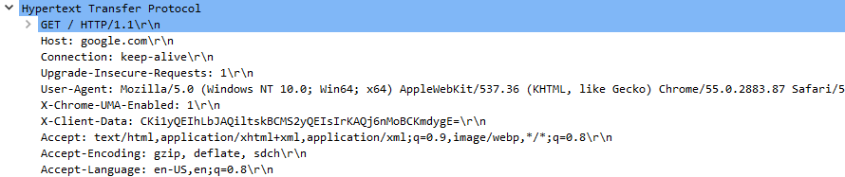
Request for www.google.com in a browser (eg Chrome)
Recall, you can use WireShark or Chrome Developer Tools
Several HTTP headers: eg, including preferred format and language

Slide 24
HTTP Body
After last header, there must be an empty line
Any data after that, if any, would be part of the payload, ie HTTP body
Request: needed for POST, PUT and PATCH
Response: needed for GET (also the other methods “might” have body, but HEAD)

Slide 25

http://www.rd.com/wp-content/uploads/sites/2/2016/04/01-cat-wants-to-tell-you-laptop.jpg

Slide 26
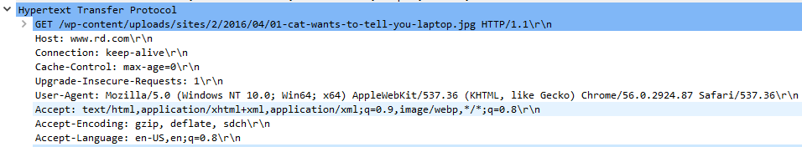
GET with no body
Have a look at the “Accept” header… there is no “jpg” there, why?

Slide 27
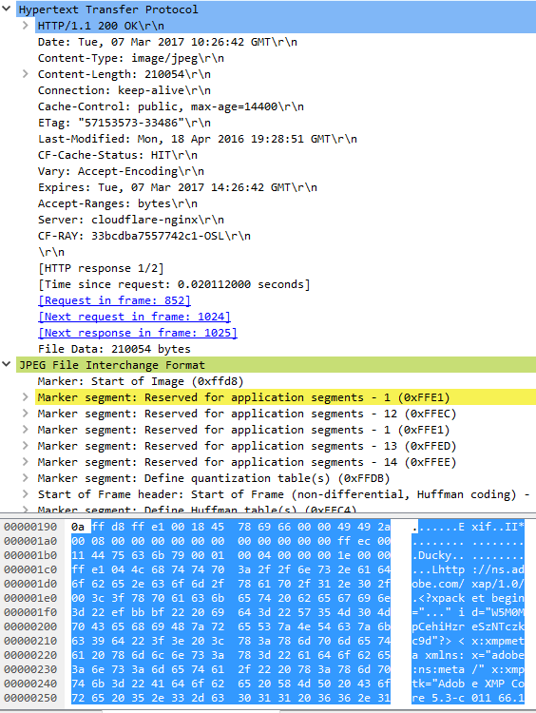
In this case, payload is in JPEG format
“Content-type” header:
need to specify the format, eg JPEG. Note this is necessary because what requested by user (“Accept”) might be a list, and also server might return something different
“Content-length” header:
Essential, otherwise HTTP parser cannot know when payload is finished
Cache handling: headers like “Cache-Control”, “ETag”, “Last-Modified”, etc.
If visiting page for second time, no need to re-download image if hasn’t changed

Slide 28
HTTP Response
Same kind of headers and body as HTTP request
Only first line does differ
<PROTOCOL> <STATUS> <DESCRIPTION>
Eg, “HTTP/1.1 200 OK”
Note: only 1 space “ ” between the tags, I added extras just for readability
When making a request, a lot of things could happen on server, and the “status” is used to say what happened

Slide 29
HTTP Status Codes
3 digit number, divided into “families”
1xx: informational, interim response
2xx: success
3xx: redirection
4xx: user error
5xx: server error

Slide 30
2xx Success
200: OK
201: resource created
202: accepted, but not completed (eg, background operation)
204: no content (eg, as result of PUT or DELETE)

Slide 31
3xx Redirection
Note: the semantics of these codes is a “mess”, being changing with different “updates” of HTTP 1.1… and being left in an inconsistent state
301 permanent redirection
If X redirects to Y, then client will never ask for X again, and go straight for Y
302 temporary redirection
“May” change verb, eg from POST to GET
307 temporary redirection, but same verb
Eg, a POST stays a POST
“Location” header: URI of where we should redirect

Slide 32
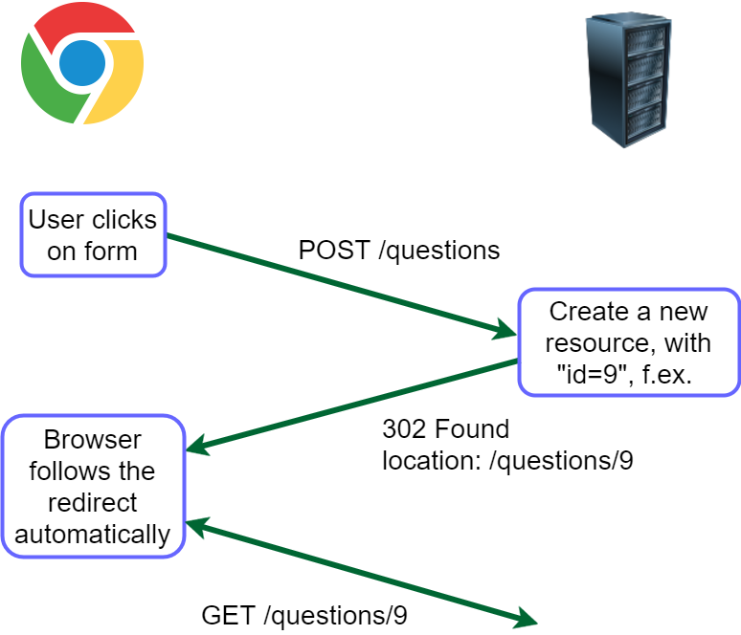

Slide 33
4xx User Error
400: bad request (generic error code)
401: unauthorized (user not authenticated)
403: forbidden (authenticated but lacking authorization, or not accessible regardless of auth)
Note: RFC 7231/7235 are rather ambiguous/confusing when it comes to define authentication/authorization, and differences between 401 and 403
404: not found (likely the most famous HTTP status code)
405: method not allowed (eg doing DELETE on a read-only resource)
415: unsupported media type (eg sending XML to JSON-only server)

Slide 34
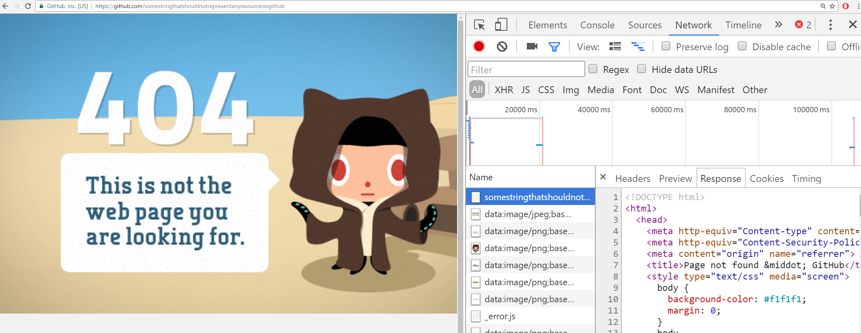
Even if error (eg 404), response can have a body, eg an HTML page to display

Slide 35
5xx Server Error
500: Internal Server Error
Often, a bug, eg an exception in the business logic (like a NPE), that propagates to the application server will be handled with a 500 response
Note: if whole application server does crash, then you get no response…
Required external services have problems, eg database connection failed
503: Service Unavailable
Eg, overloaded of requests, or scheduled downtime for maintenance

Slide 36
HTTPS (HTTP Secure)
Encrypted version of HTTP, using Transport Layer Security (TLS)
Usually on port 443 instead of 80
URIs are the same as in HTTP (just the “scheme” does change)
Note, the whole HTTP messages are encrypted, but still using TCP
this means it is still possible to find out the IP address and port of remote server, although cannot decipher the actual sent messages
this issue can be avoided by going through proxy networks like TOR , or any VPN provider (but this latter would know what you visit)

Slide 37
Git Repository Modules
NOTE: most of the explanations will be directly in the code as comments, and not here in the slides
advanced/example-news
advanced/rest/news-rest
Study relevant sections in RFC-7230 and RFC-7231

